Slide 1
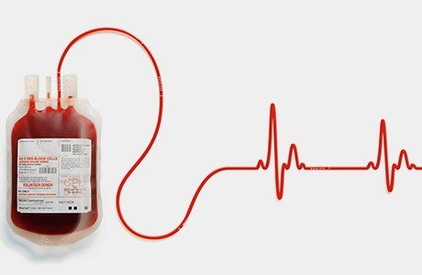
BLOOD BANK IMPLEMENTATION SYSTEM
Group No:1
Ashwini Gujar - EBEON0721406651
Chaitali Chaudhari - EBEON0721405408
Pramila Gaikwad - EBEON0721410236
Sneha Surendran - EBEON0721407301

Slide 2
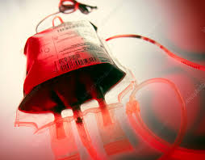
Contents:-
Home
Donor
Recipient
Volunteer
Guidelines
Login

Slide 3
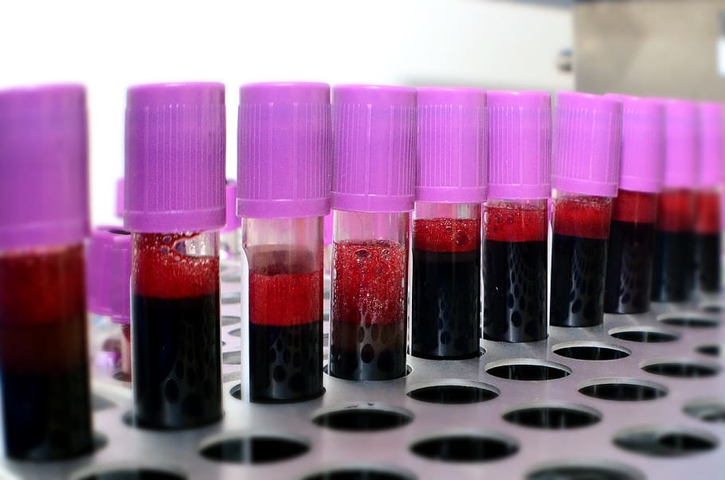
Introduction
The basic building aim is to provide blood donation service to the Country.
This project aims at maintaining all the information pertaining to blood donors, different blood groups available in blood bank.

Slide 4
Home
Home Page done by Ashwini Gujar.
A Home Page is the main web page of a website.

Slide 5
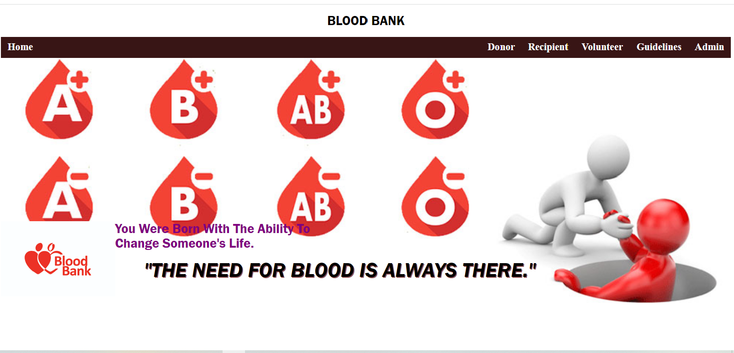

Slide 6
Donor
Done by Sneha Surendran.
The number of persons who are in need of blood are increasing in large number day by day.
In order to help people who are in need of blood, our project can be used effectively for getting the details of blood donors having the same blood group .
People who are having the thought of donating blood gets registered giving their total details.

Slide 7
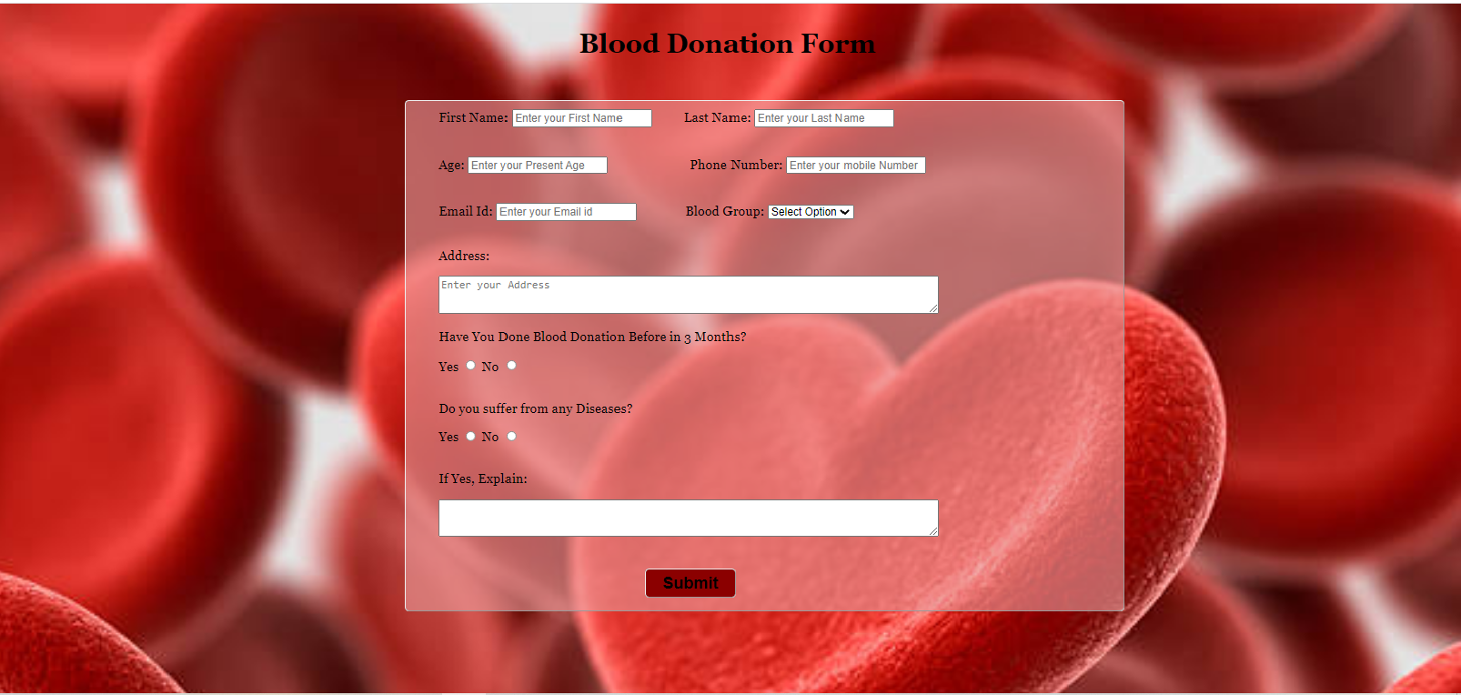

Slide 8
Recipient
Done by Chaitali Chaudhari.
A recipient is a person who requires blood.
In our project a person can register his details and can search the availability of the blood group he/she required.

Slide 9
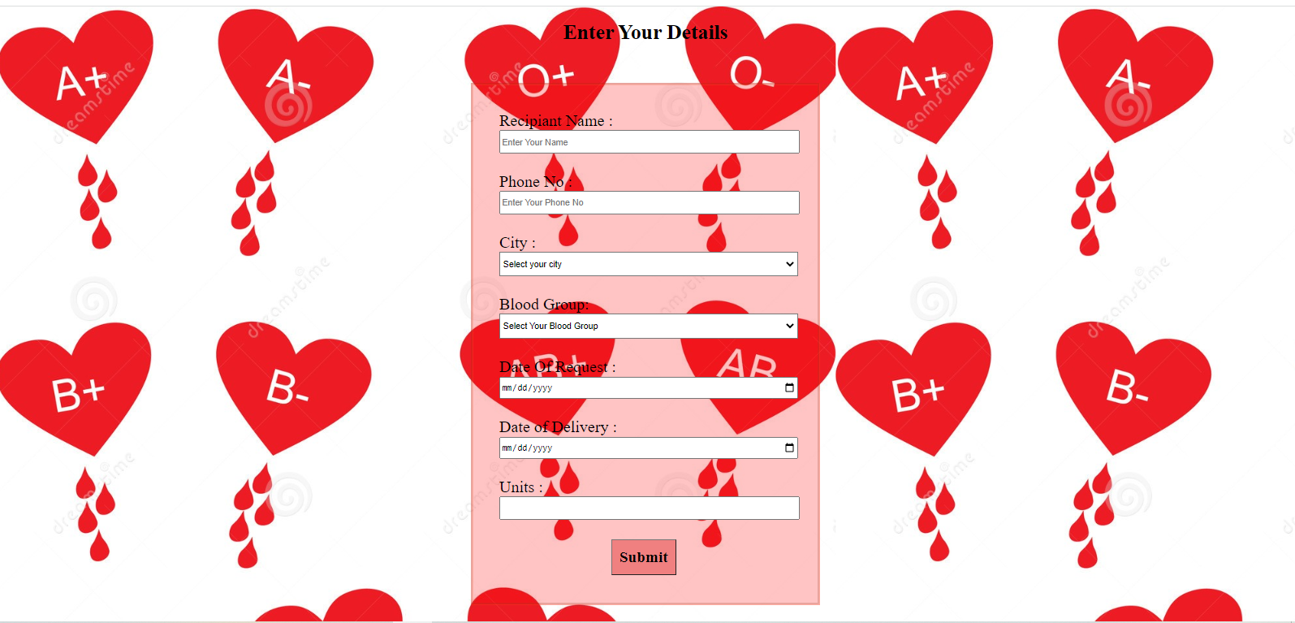

Slide 10

Guidelines
Done by Pramila Gaikwad.
Guidelines are given just to provide an awareness to the donors about the Do’s and Don’ts of blood donation .
Do’s
The donor must be fit and healthy.
Should not be suffering from transmittable diseases.
The donor must be 18-65 years of age and should be minimum 50kg weight.

Slide 11

Don’ts
A person who has been tested HIV positive.
Women who are pregnant or breastfeeding
Individuals who have had fits, tuberculosis, allergic disorders in the past.

Slide 12
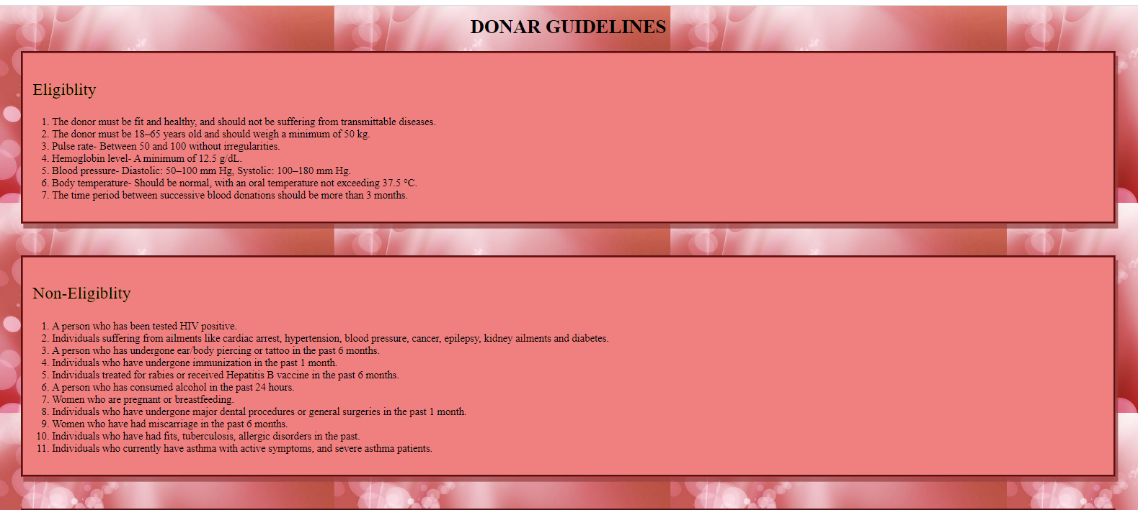
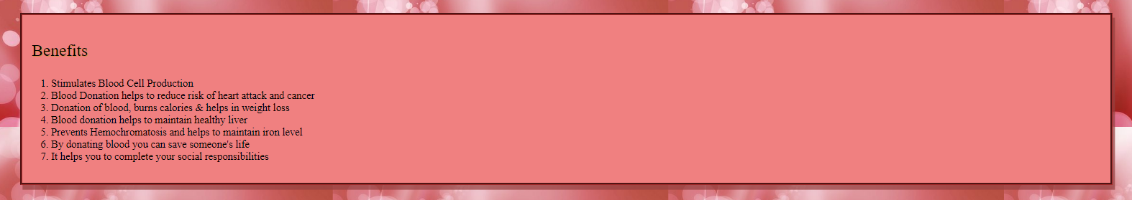

Slide 13
Login
Done by Ashwini Gujar.
Once an account is created by a user then he/she can login through the admin page for further procedures.

Slide 14
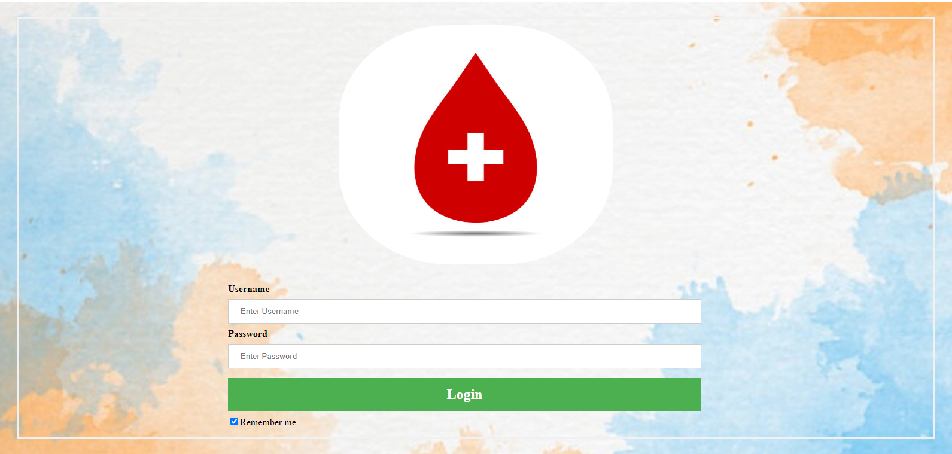

Slide 15
Volunteer
Done by Sneha Surendran.
Those person who are willing do volunteer the campaign can register through the volunteer page provided by us so if required they will be contacted in their registered phone number or Mail id.

Slide 16
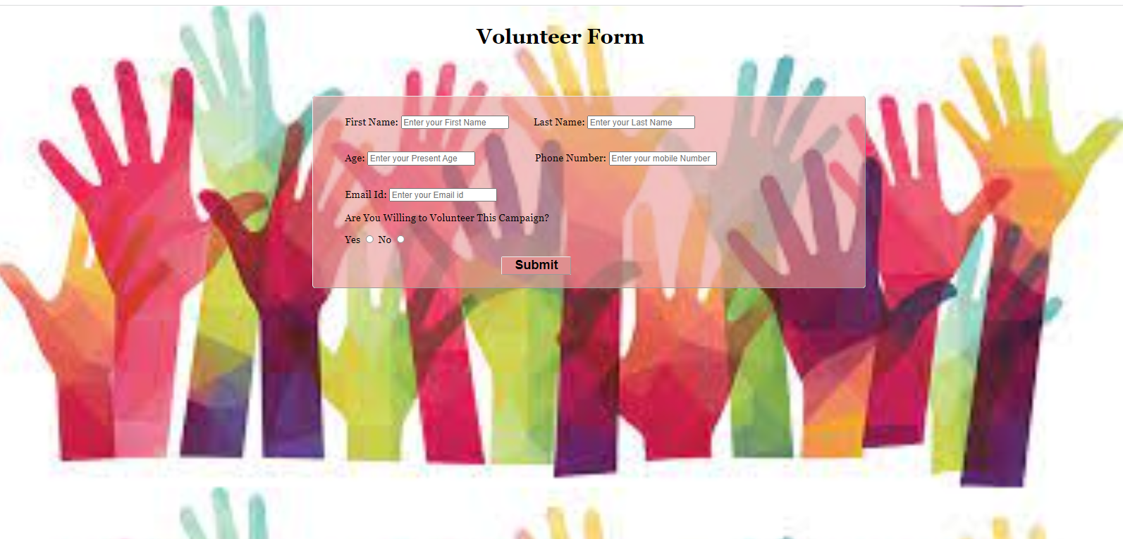

Slide 17

“Blood Donation will cost you nothing, but it will save a life!”

Slide 18

THANK YOU…

